Slide 1
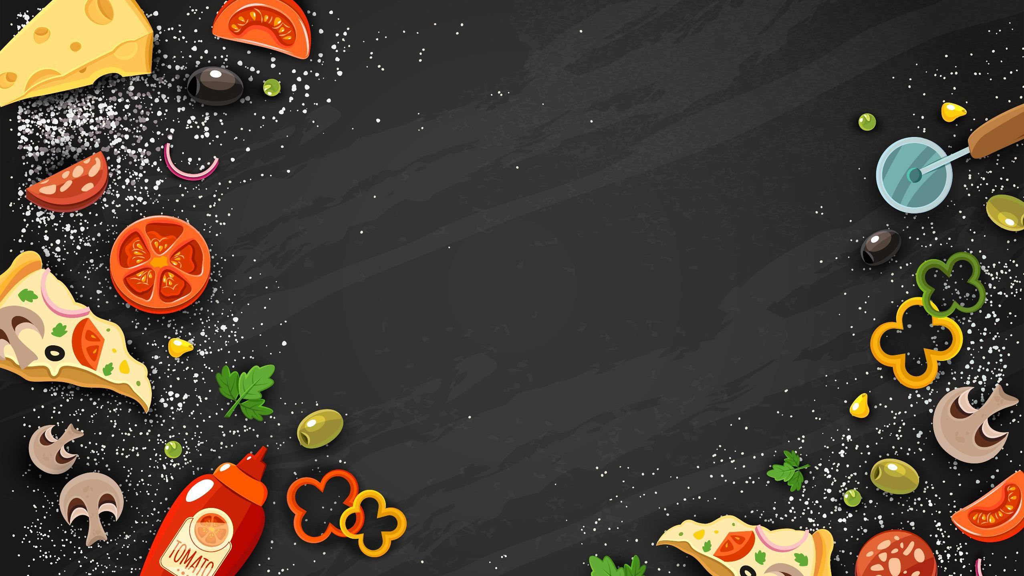

Welcome to my presentation
Cloud Kitchen

Slide 2

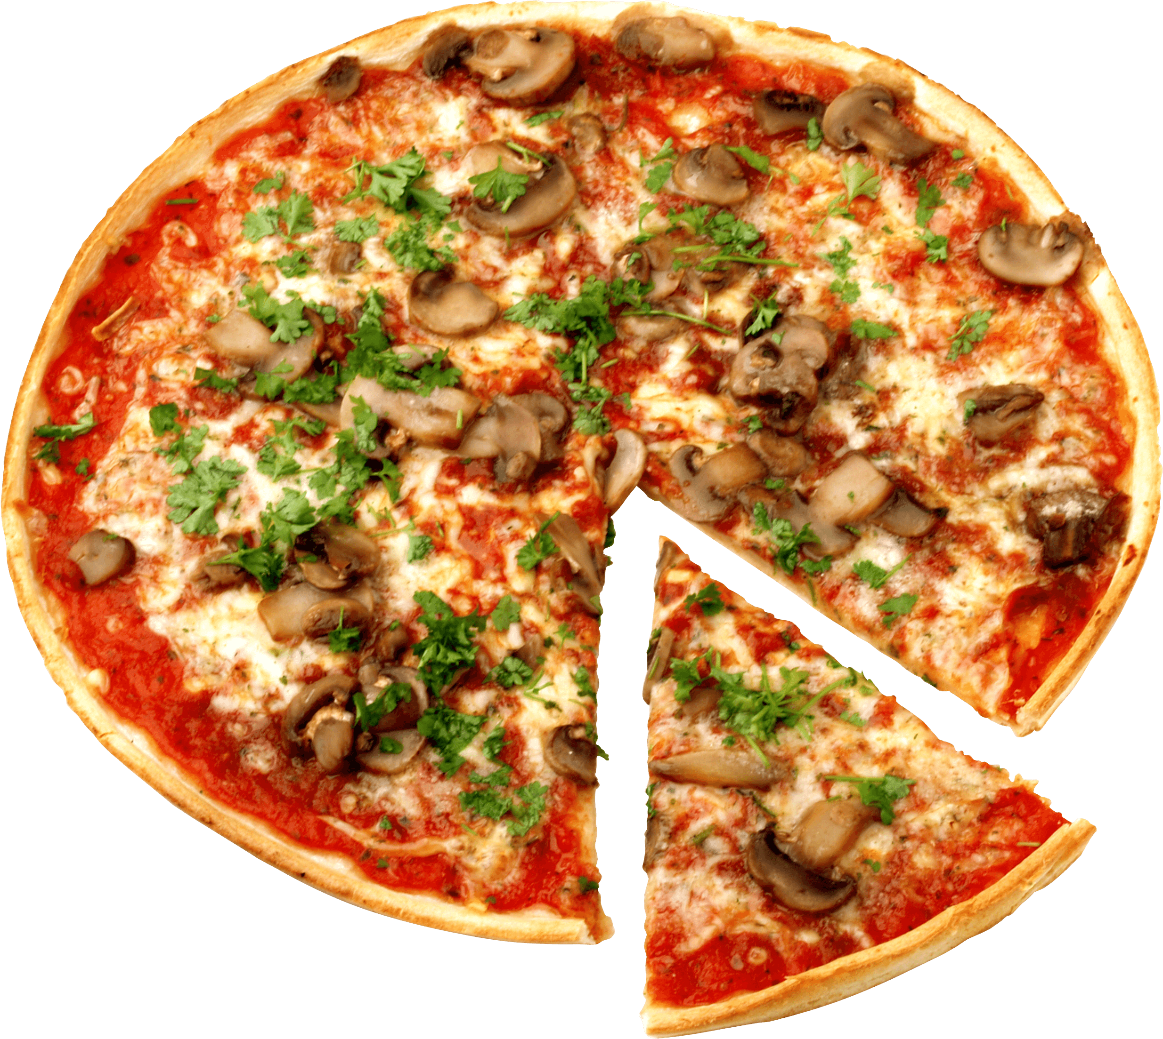
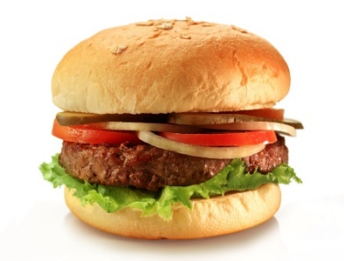

Business plan about “CLOUD KITCHEN’’
Cloudy Spoon

Slide 3



What is Cloud Kitchen?
A Cloud Kitchen utilizes a commercial kitchen for the purpose of preparing food for delivery or takeout only, with no dine -in customers.

Slide 4
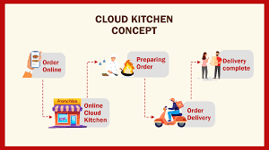

Slide 5


SWAT Analysis of Cloudy Spoon
SWOT analysis is a framework for identifying and analyzing an organization's strengths, weaknesses, opportunities, and threats. These words make up the SWOT acronym. It is
used to evaluate a company's competitive position and to develop strategic planning.

Slide 6

Strengths of Cloud Kitchens:
Some of the key strengths include:
Cost-effective nature
Cloud kitchens provide a flexible
leverage technology

Slide 7


Weaknesses of Cloud Kitchens:
Some of the key weakness include:
Cloud kitchens heavily rely on third-party
Managing food quality

Slide 8

Opportunities in the Cloud Kitchen Market:
Experience of significant growth in global cloud kitchen market
Efficient delivery systems and technologies

Slide 9

Threats to Cloud Kitchens:
The growing popularity of cloud kitchens
Economic downturns
Dependency

Slide 10
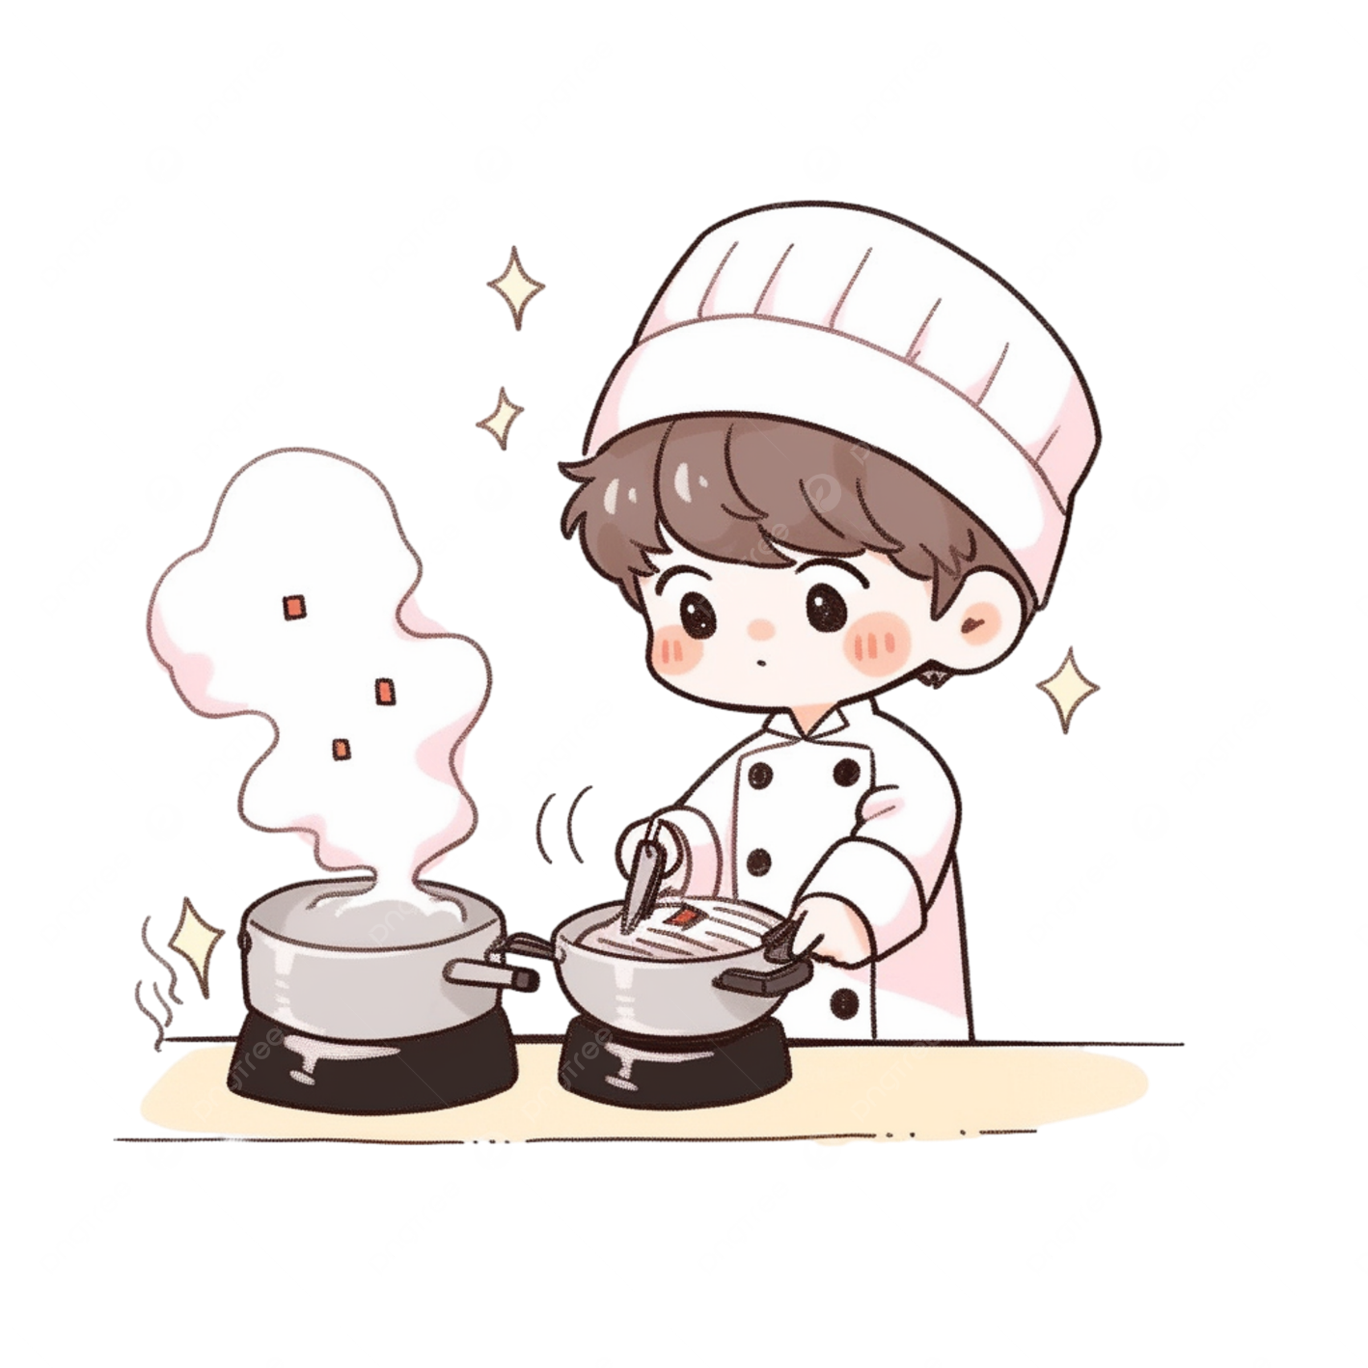


How to start?
Decide a location
Acquire required license to start the business Finding the suitable online orders
Buying necessary equipment Hiring the right team
Point of sale technology Unique marketing activities

Slide 11

Start with deciding a location:
To decide a suitable location the first concern is right rental space which provide proper sanitation, water supply and maintenance.

Slide 12


Acquiring license :
Get name clearance
Prepare memorandum of association and article of association
Once that is sorted, we get trade license
Required health certification
Fassai license
Shop and establishment license
GST registration
Fire NOC
Local municipal license

Slide 13

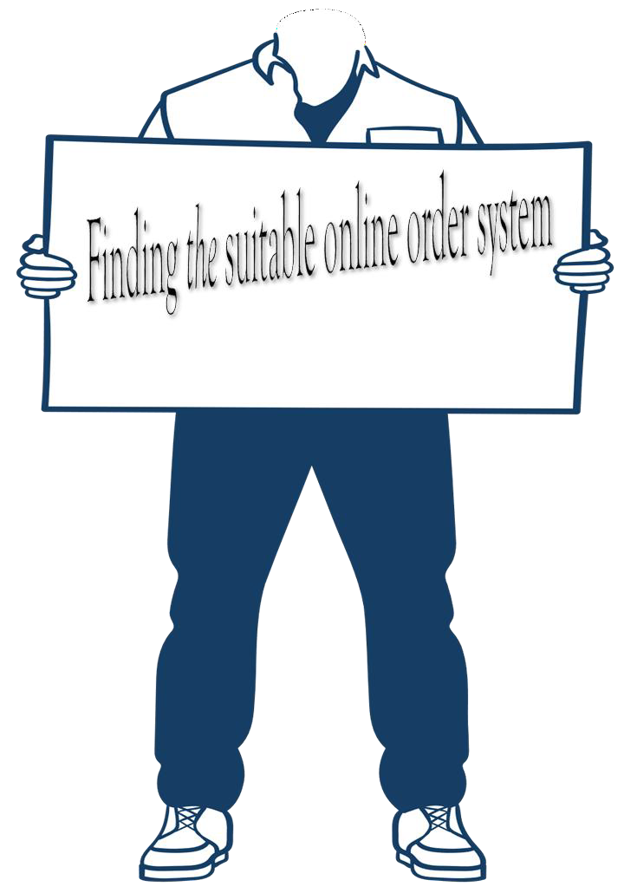

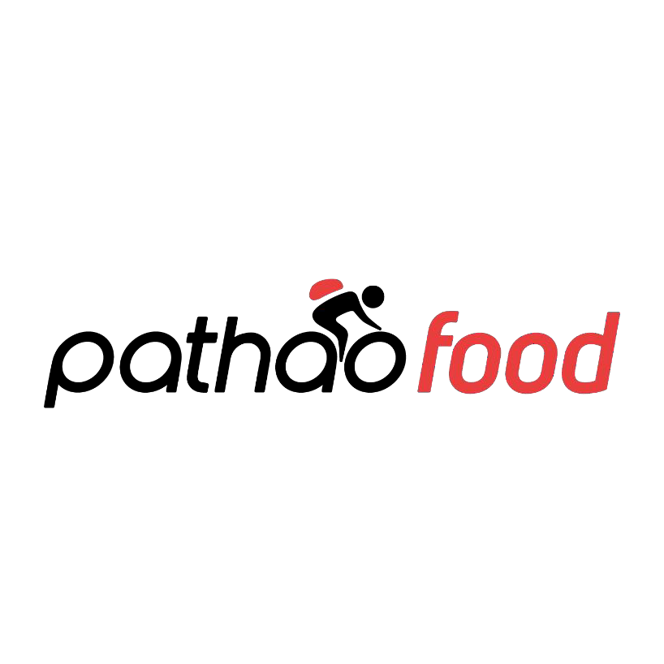


Slide 14
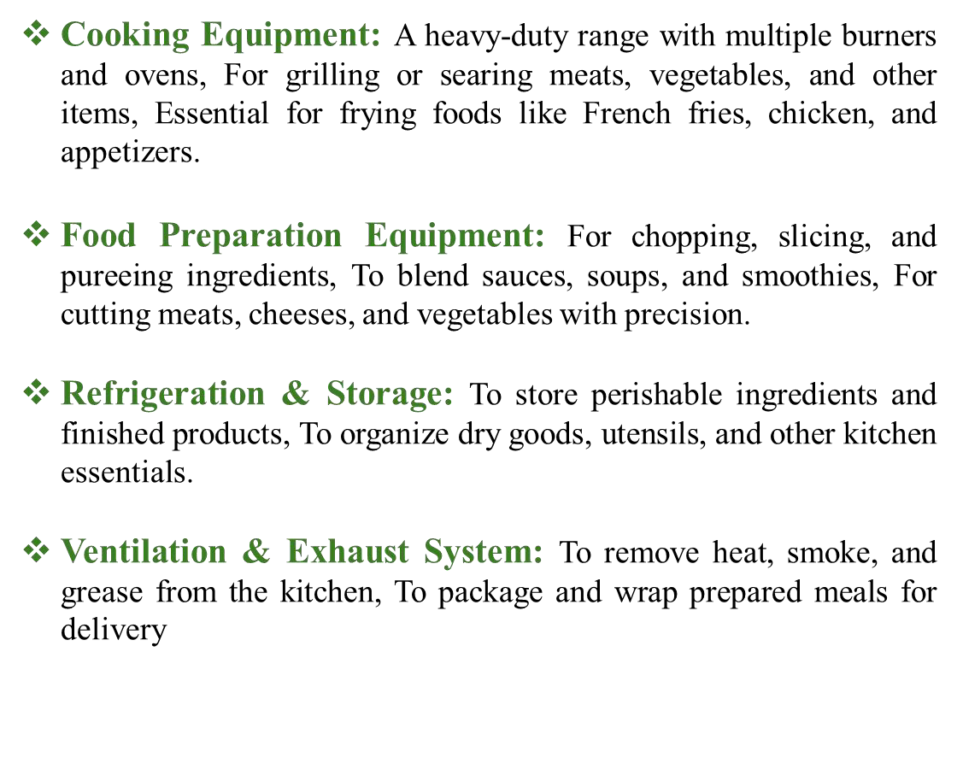
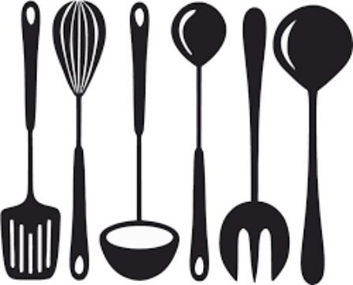
Buying the Equipment

Slide 15

Hiring the Right Team
The success secret of a cloud kitchen laid a lot on the Head Chef and the assistants who help. Their proper R&D makes an alluring menu that customers can’t resist.

Slide 16
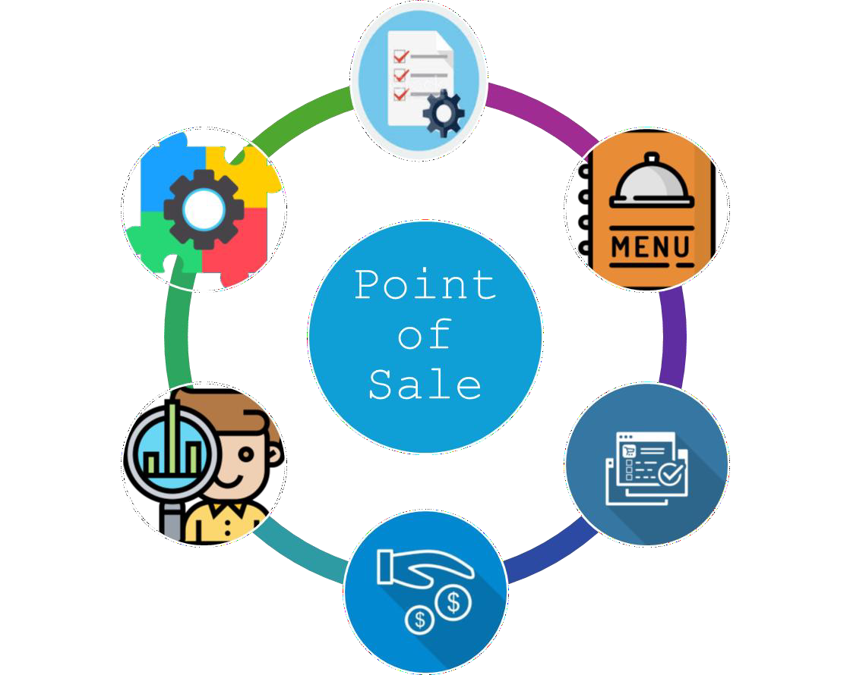

Slide 17

Other miscellaneous items:
Packaging Supplies
Cleaning Supplies
Insurance
Uniforms and Safety Geared
Marketing Materials
Utilities
Training Materials
First Aid Kit
Waste Management
Accounting Software
Customer Feedback System

Slide 18

Marketing activities:
Social Media Influencer Partnerships
Localized Social Media Campaigns
Food Festivals and Events
Collaborations with Local Businesses
Food Delivery Platforms Promotion
Virtual Cooking Classes
Cultural and Seasonal Promotions

Slide 19
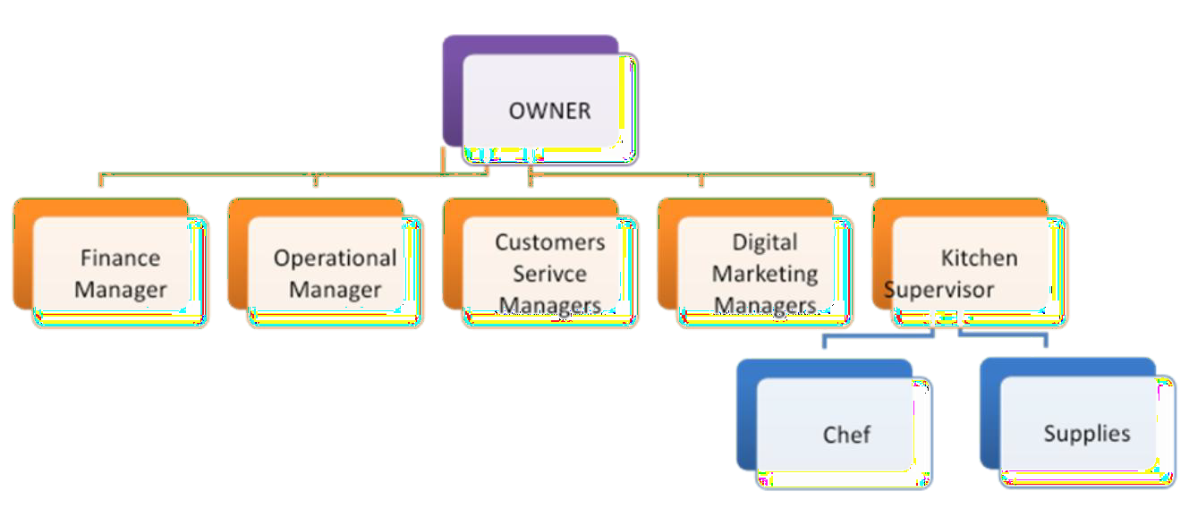
Management of Cloudy Spoon

Slide 20
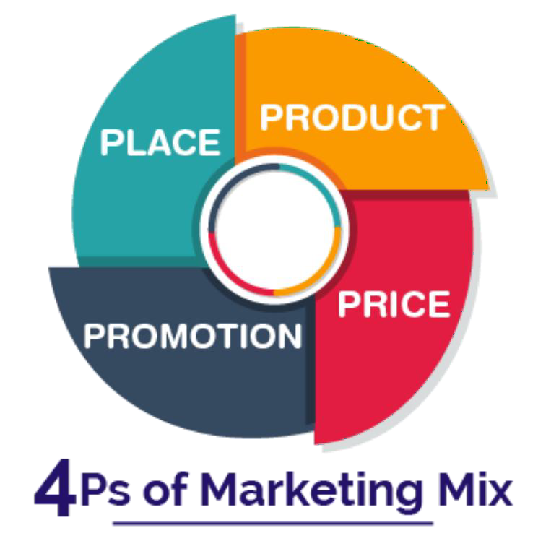
Marketing Mix

Slide 21

Product:
This refers to what a company offers to its customers.
Brand
Quality
Look
Hygiene
Fresh
Packaging
Competitor
Point of difference

Slide 22
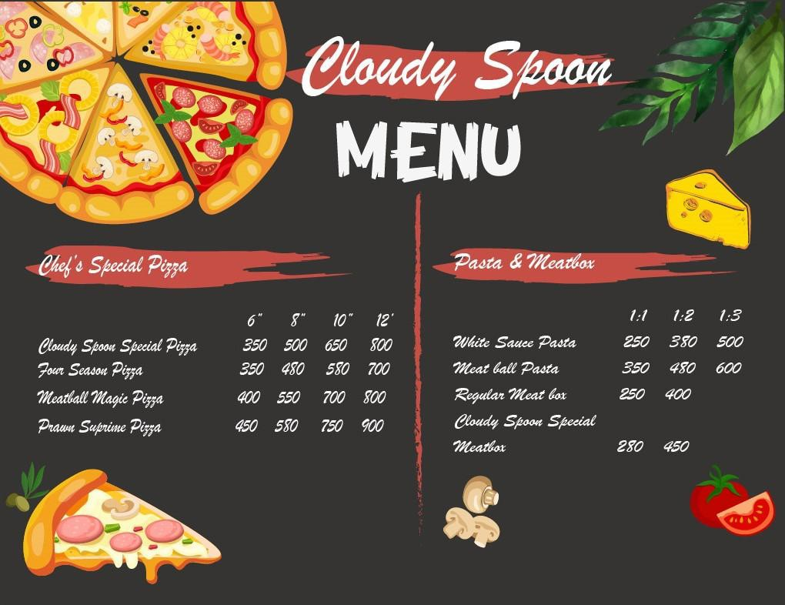
Price:
Price reflects the value that customers perceive in a product or service.
Penetration format based

Slide 23
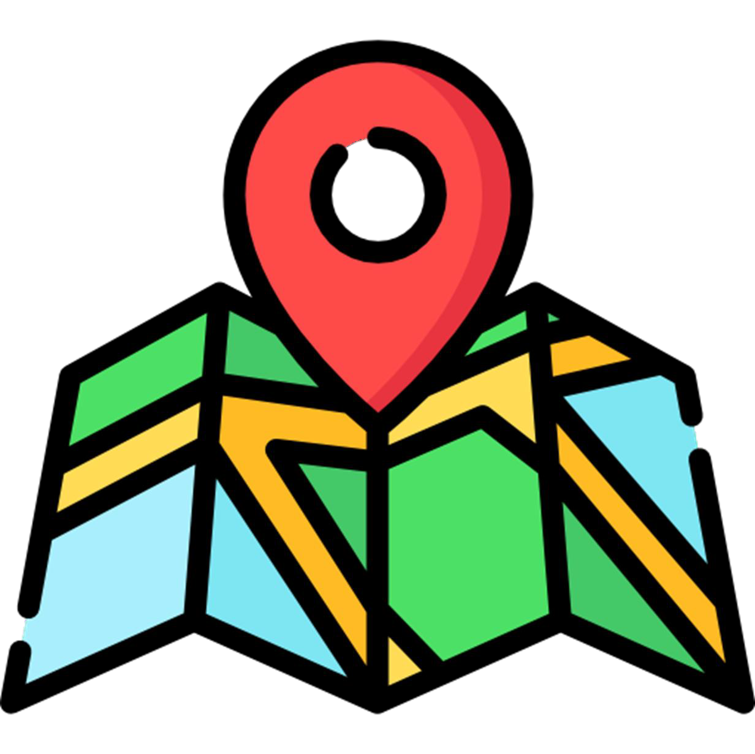
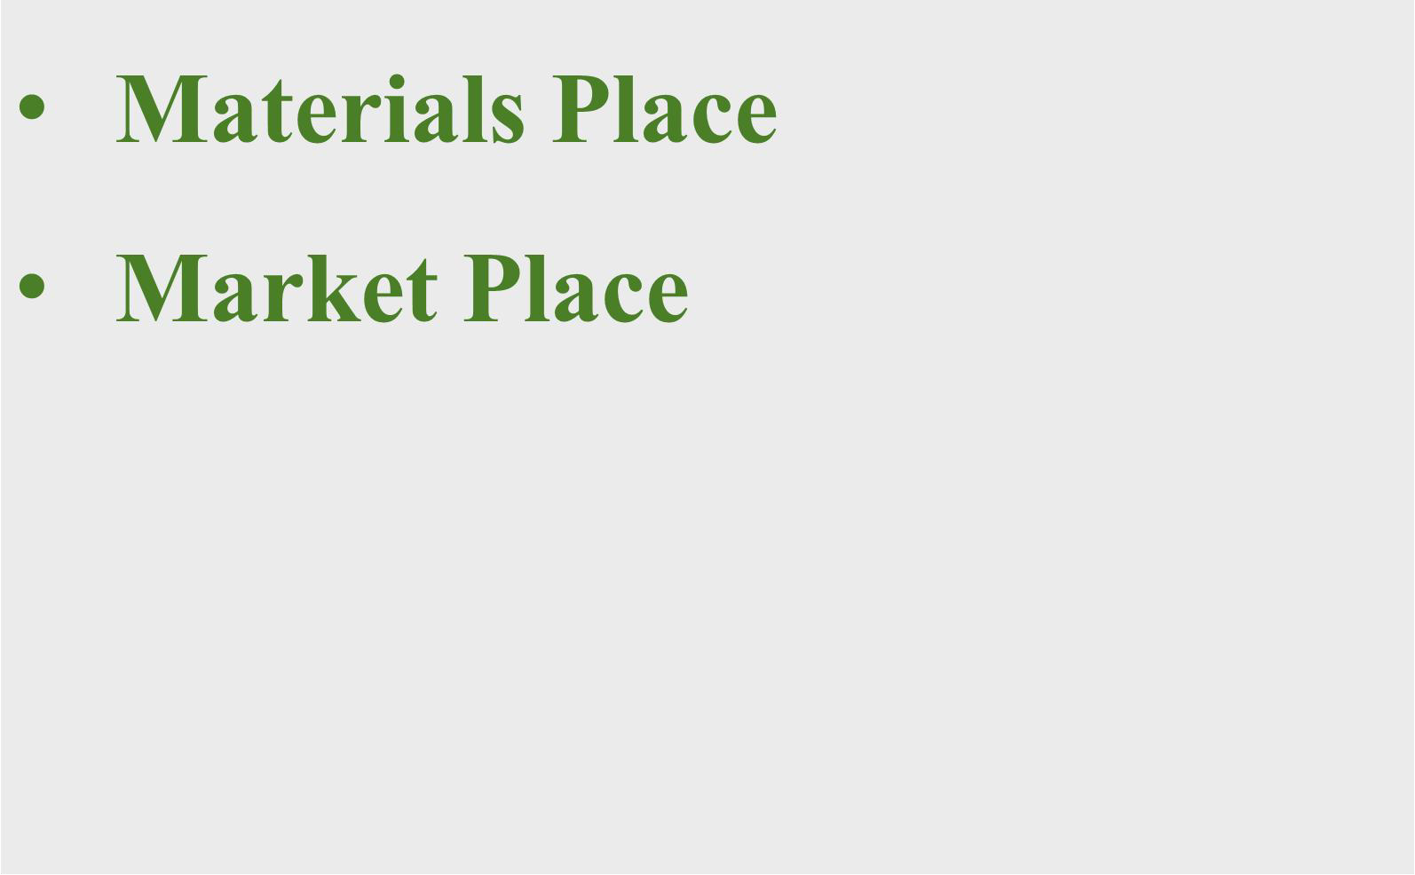
Place:
Where will the product be made & sold

Slide 24

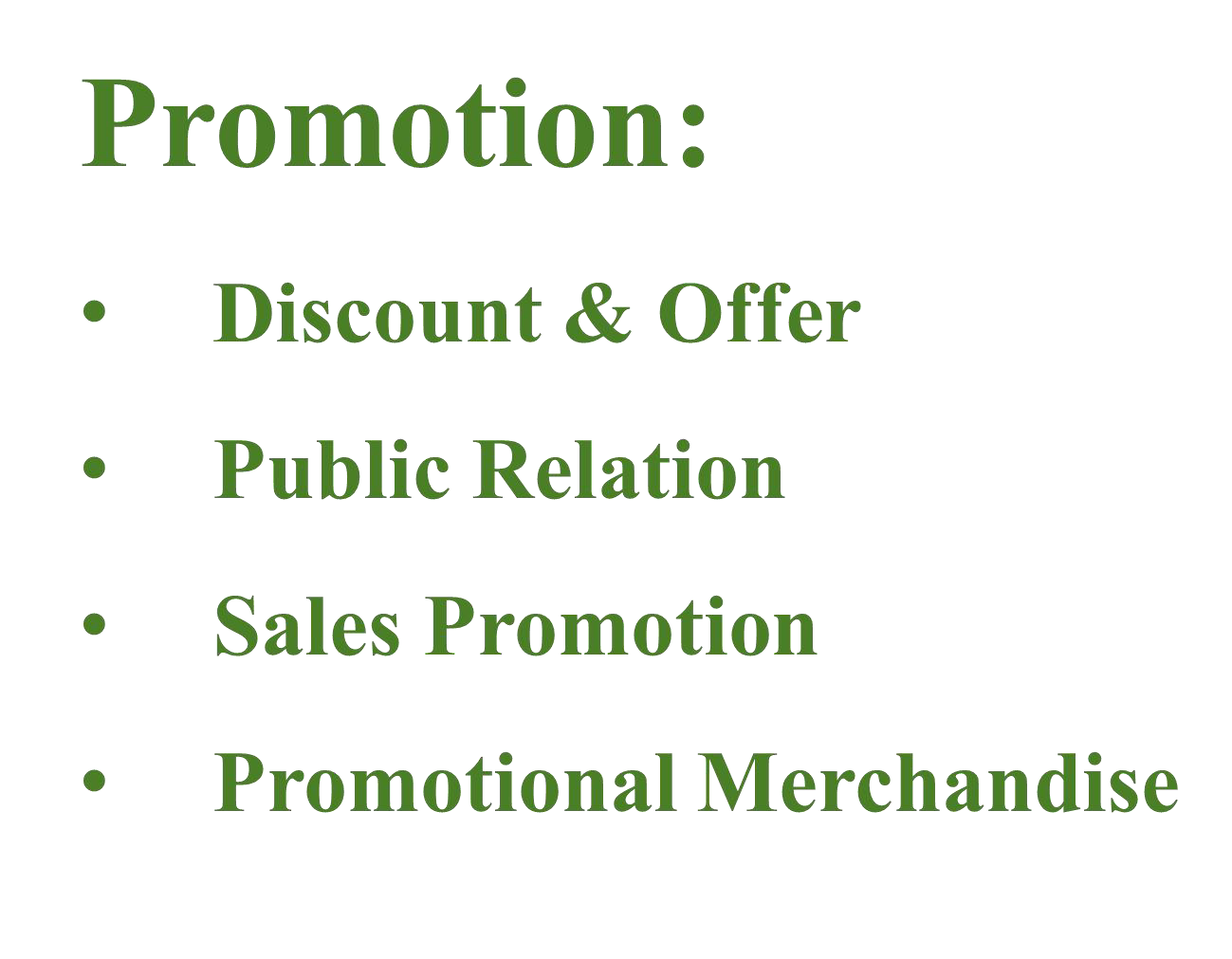


Slide 25
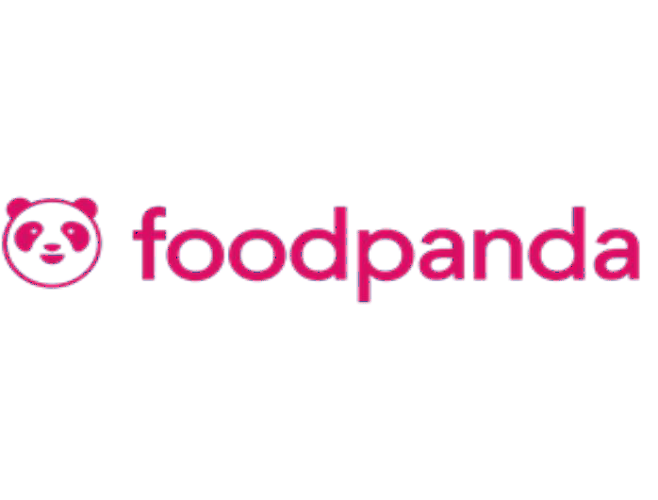



Advertising Channel
Online Based
Facebook
Instagram
Build Up Software
Food Delivery App
PR Sending
Offline Based
Posters
Hand Bill
Sales Promotion

Slide 26
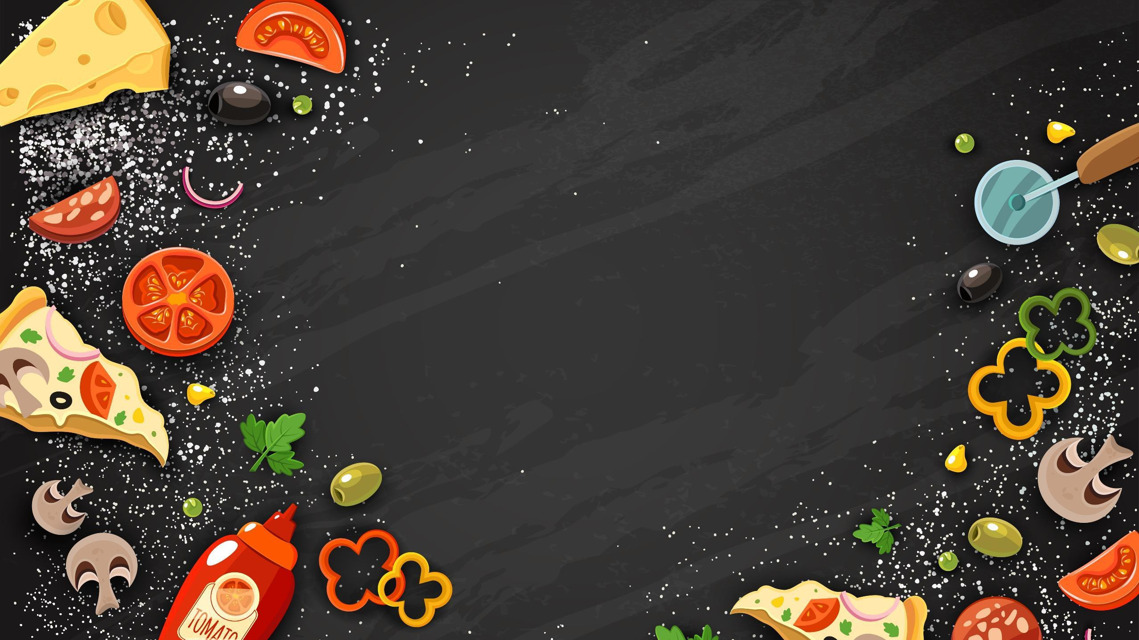
THANK YOU ALL

